Slide 1
Rodrick Whetstone Southern Illinois University Edwardsville Sarah Dobie (Buila) Southern Illinois University Carbondale
Murder, Social Murder and Social Control: Can Art raise Awareness and instigate social change?
National Association of African American Studies and Affiliates
33rd Annual Joint National Conference February 13-15, 2025

Slide 2
Faulty Reasoning
Police brutality against people of color

Slide 3
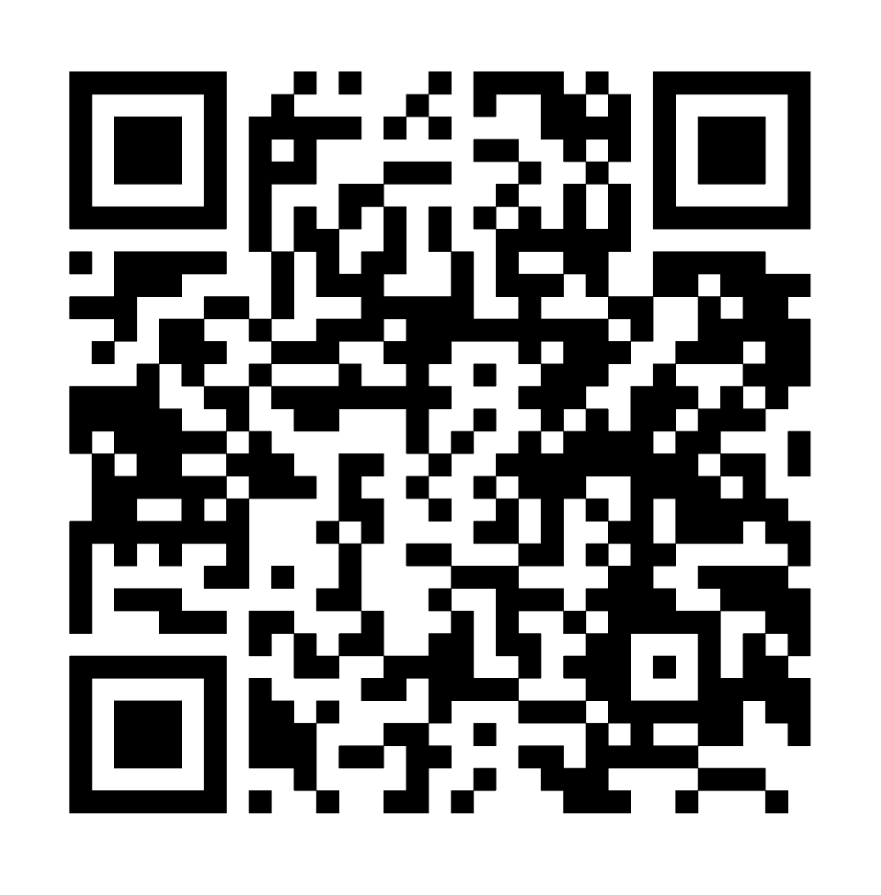
Access to the PowerPoint
Use your smart phone or tablet to follow this link to download the PowerPoint from my website.
www.rodrickwhetstone.com

Slide 4
Whetstone presentation outline
A very brief history of posters
Poster anatomy basics
The actual protest posters made by Professor Whetstone

Slide 5
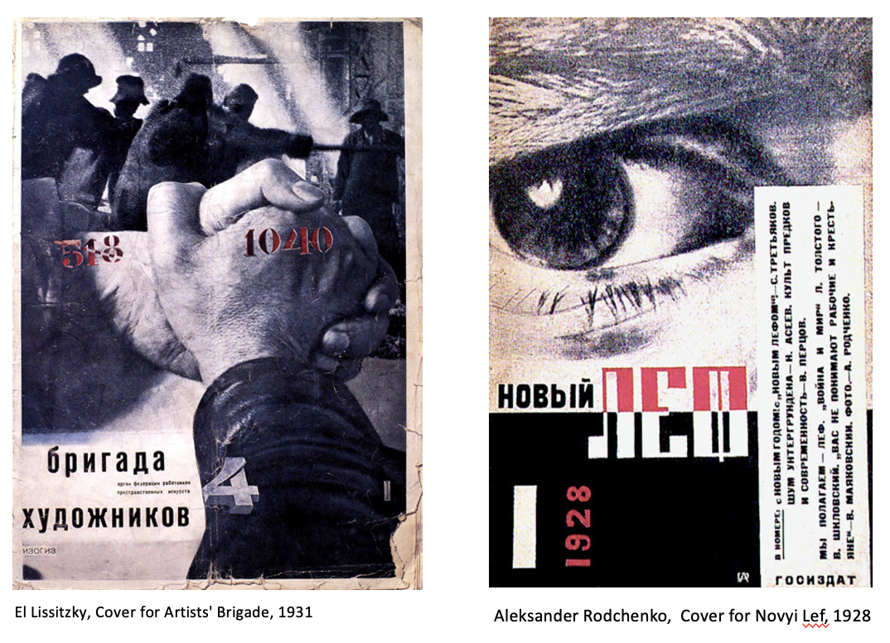
A brief history of the poster
1920s Russian Constructivist propaganda favored art as a practice directed towards social change or that would serve a social purpose. It rejected art for art sake.

Slide 6
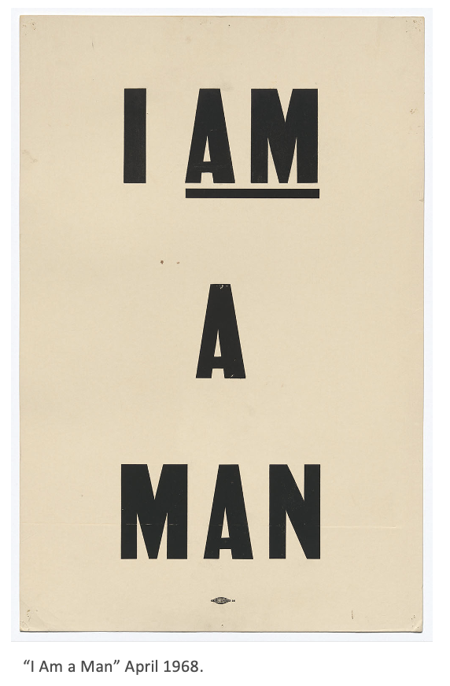
A brief history of the protest poster
Fast-forward to 1968 “I Am A Man”. This poster is a struggle for quality and human safety.
“February 1968, an old garbage truck malfunctioned, killing two Black crewmen: Echol Cole and Robert Walker. Days later, 1300 workers, backed by the American Federation of State, County, and Municipal Employees (AFSCME), walked off the job. The strike would last 64 days, ending in both triumph and tragedy.”

Slide 7
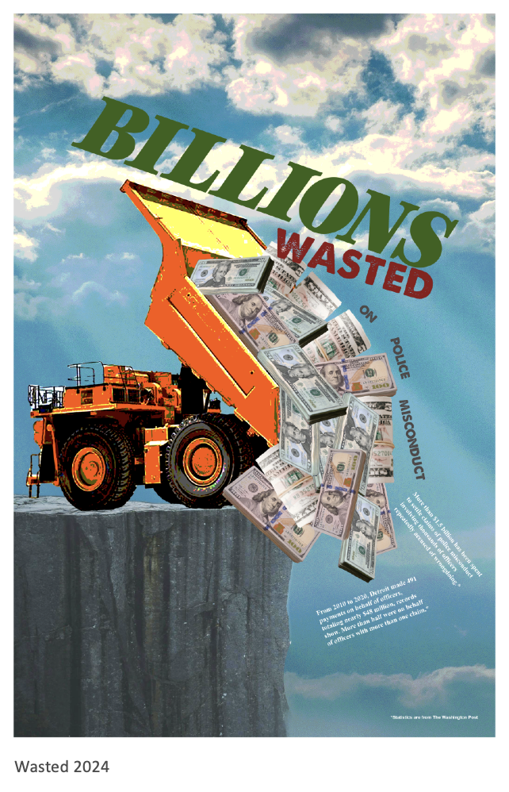
Poster anatomy basics
Hierarchy.
Call from afar, or the “why”.
The information that keeps the audience’s attention.
Full message delivery.
Keep the design simple.

Slide 8
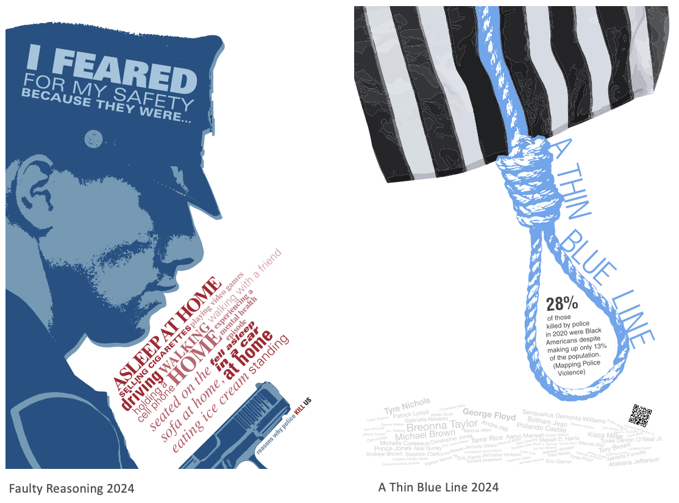
Whetstone protest posters

Slide 9
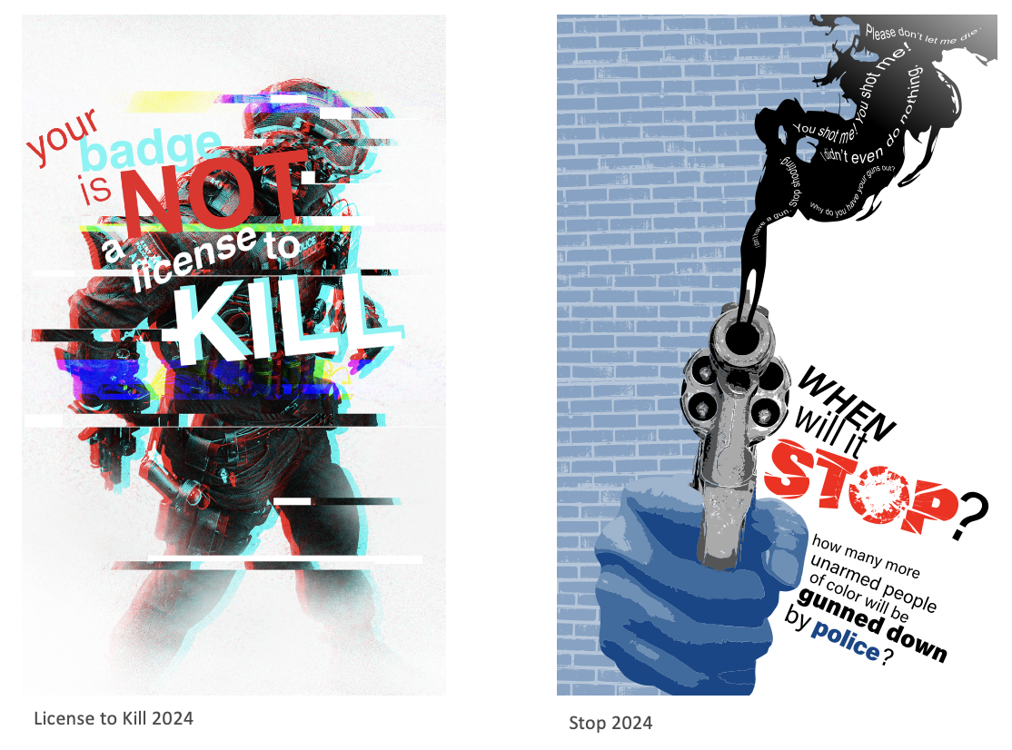
Whetstone protest posters

Slide 10
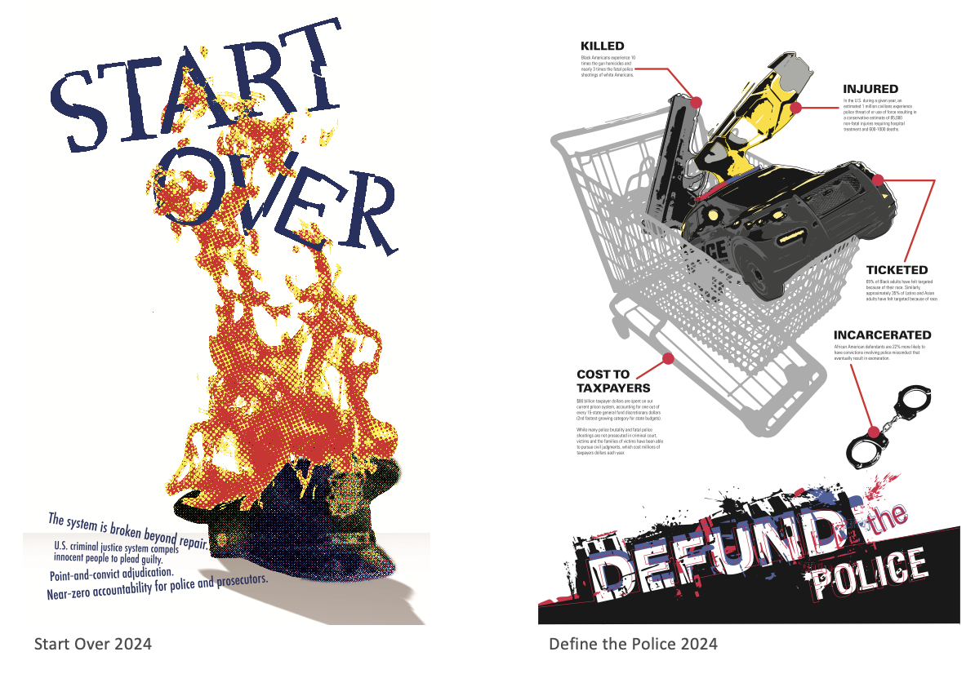
Whetstone protest posters

Slide 11
Bibliography
http://www.designishistory.com/1920/constructivism/
https://educators.aiga.org/beyond-the-bauhaus-i-am-a-man/

Slide 12
Family Legacy

Slide 13
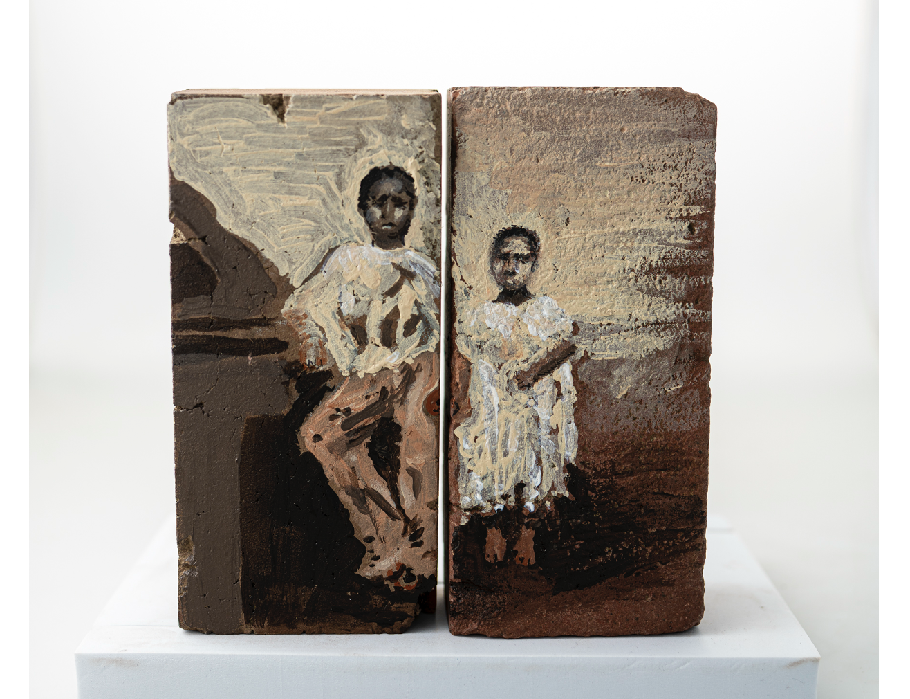

Slide 14
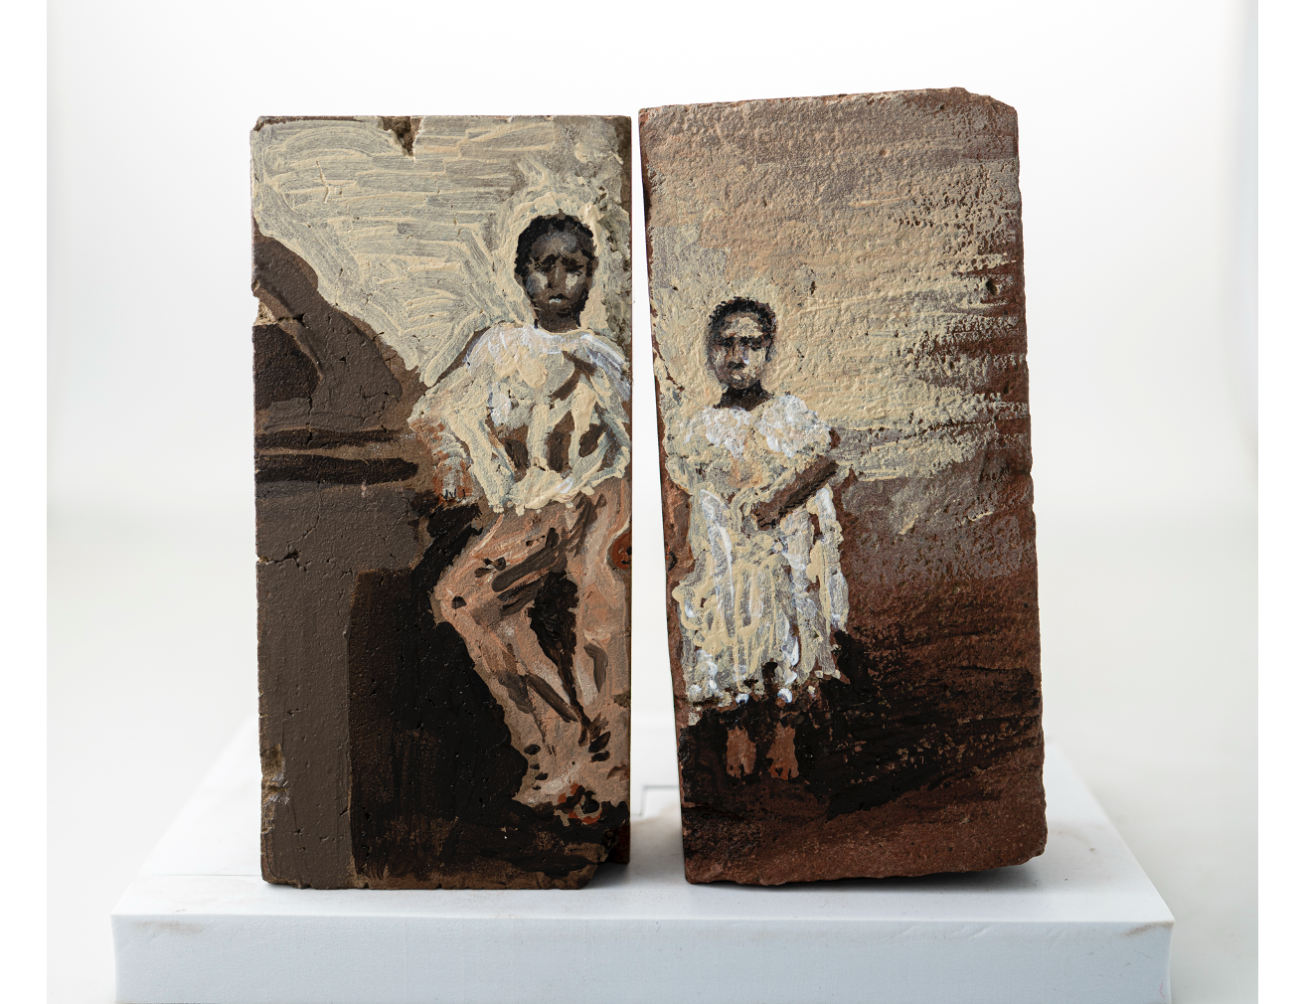

Slide 15
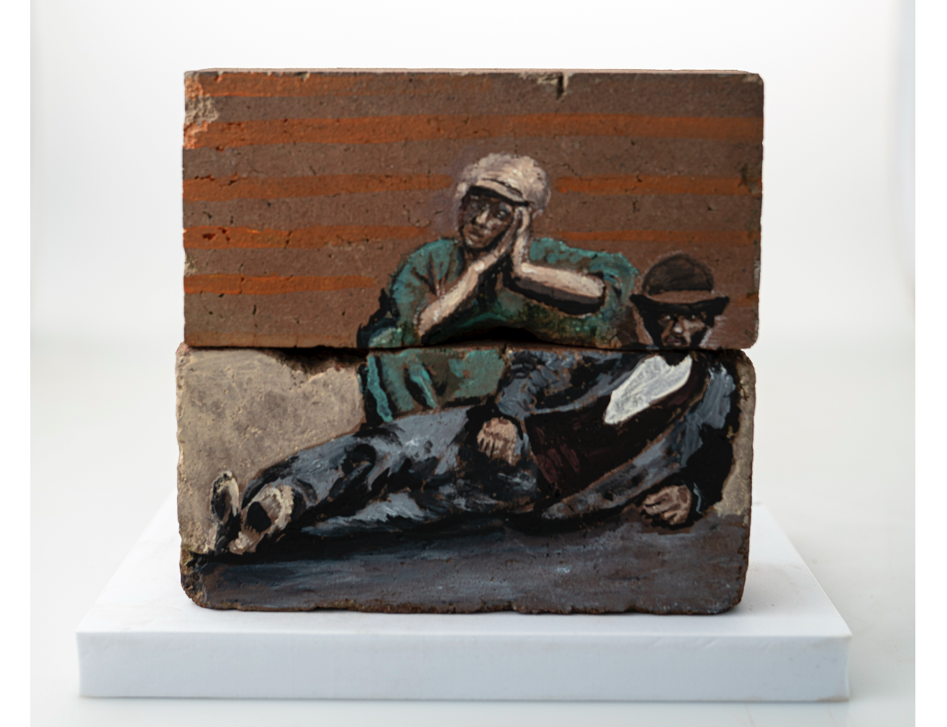

Slide 16
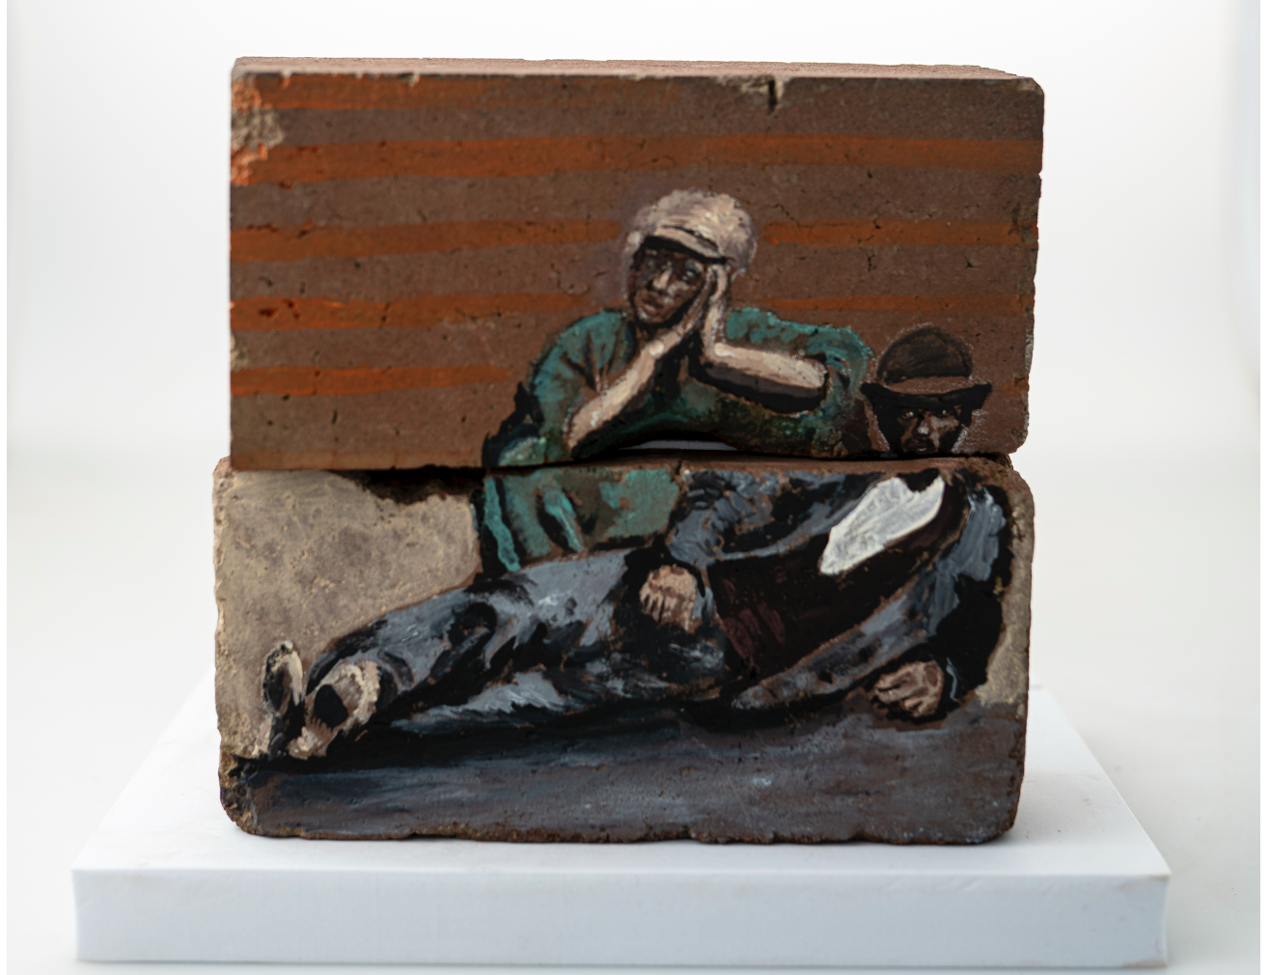

Slide 17
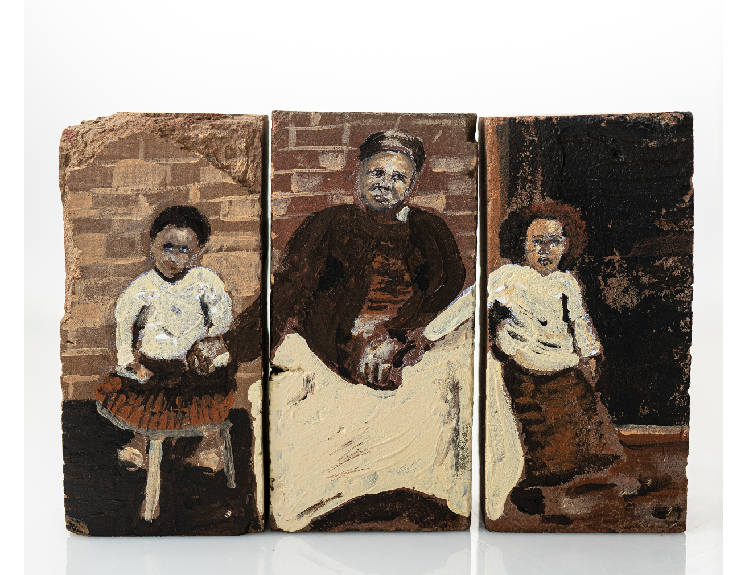

Slide 18
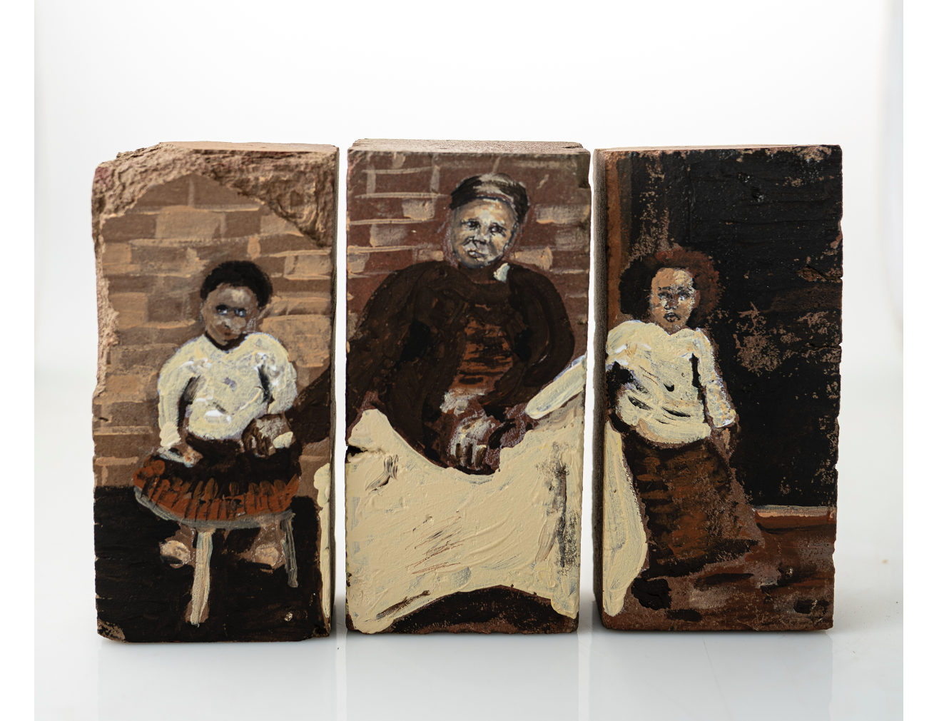

Slide 19
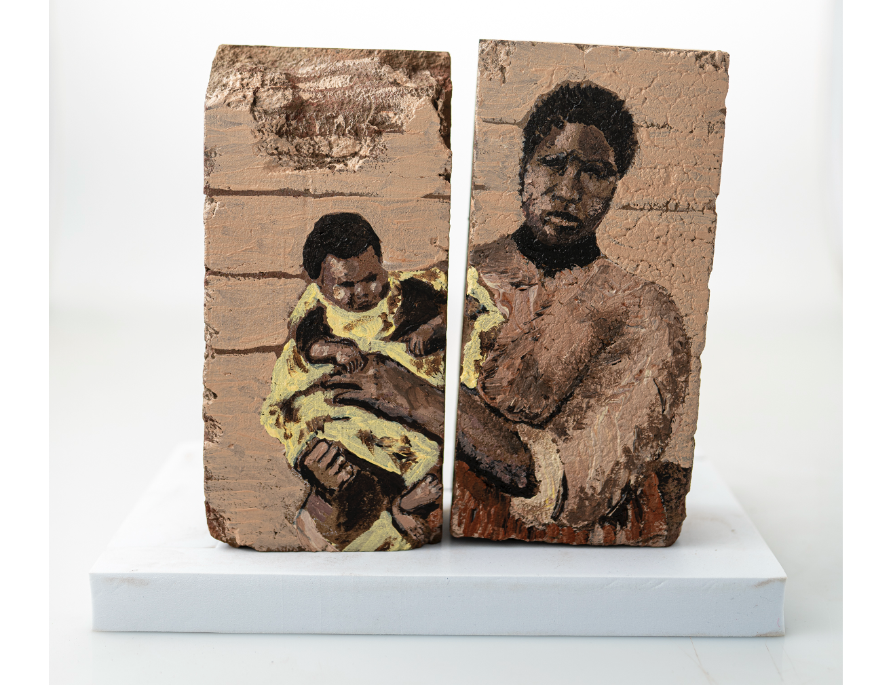

Slide 20
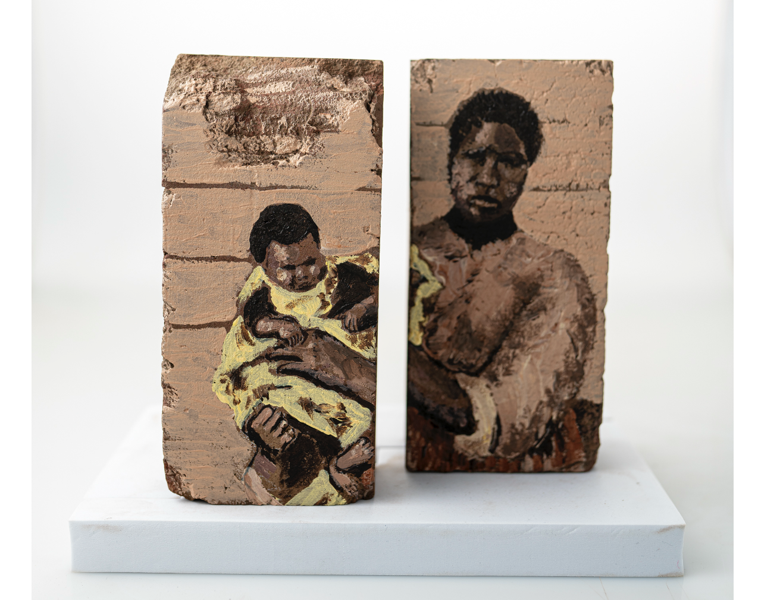

Slide 21
Questions/Discussion
Thank you

